Slide 1
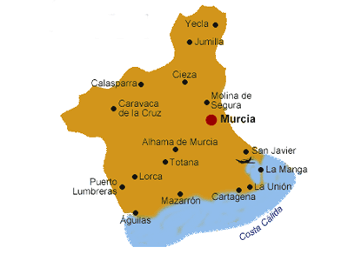




Slide 2
Parámetros climáticos promedio de Cartagena
Mes | Ene. | Feb. | Mar. | Abr. | May. | Jun. | Jul. | Ago. | Sep. | Oct. | Nov. | Dic. | Anual
Temp. máx. abs. (°C) | 25.8 | 28.2 | 30.5 | 34.8 | 37.3 | 39.6 | 43.8 | 42.1 | 38.7 | 34.1 | 30.8 | 24.6 | 43.8
Temp. máx. media (°C) | 18.2 | 19.3 | 20.4 | 22.0 | 24.3 | 28.4 | 33.5 | 33.1 | 30.0 | 27.5 | 22.7 | 19.6 | 24.9
Temp. media (°C) | 13.7 | 14.6 | 15.4 | 17.3 | 20.1 | 24.0 | 28.2 | 28.7 | 25.7 | 22.8 | 19.0 | 15.1 | 20.4
Temp. mín. media (°C) | 9.1 | 9.9 | 10.4 | 12.6 | 15.8 | 19.7 | 22.9 | 24.3 | 21.5 | 18.1 | 15.3 | 10.6 | 15.9
Precipitación total (mm) | 27 | 19 | 24 | 30 | 26 | 12 | 3 | 6 | 26 | 49 | 37 | 36 | 295
Fuente nº1: AEMET

Slide 3
